Slide 1
Library Reservation
Amith Kumar Das Orko Rachael Eapen
Lilly Jackson
Oct 28, 2026

Slide 2
Our Project
Study Room Reservation:
Issues
  Timing
  Location
  Size and Types of Rooms
  Layout
Solution
  Clean & Simple UI
  Filtering

Slide 3
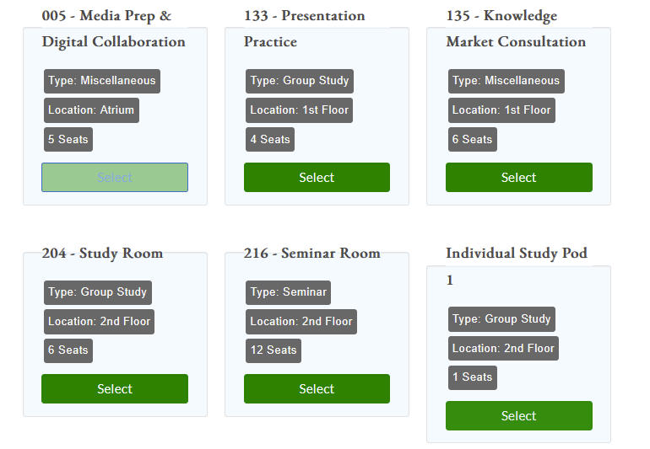

Slide 4
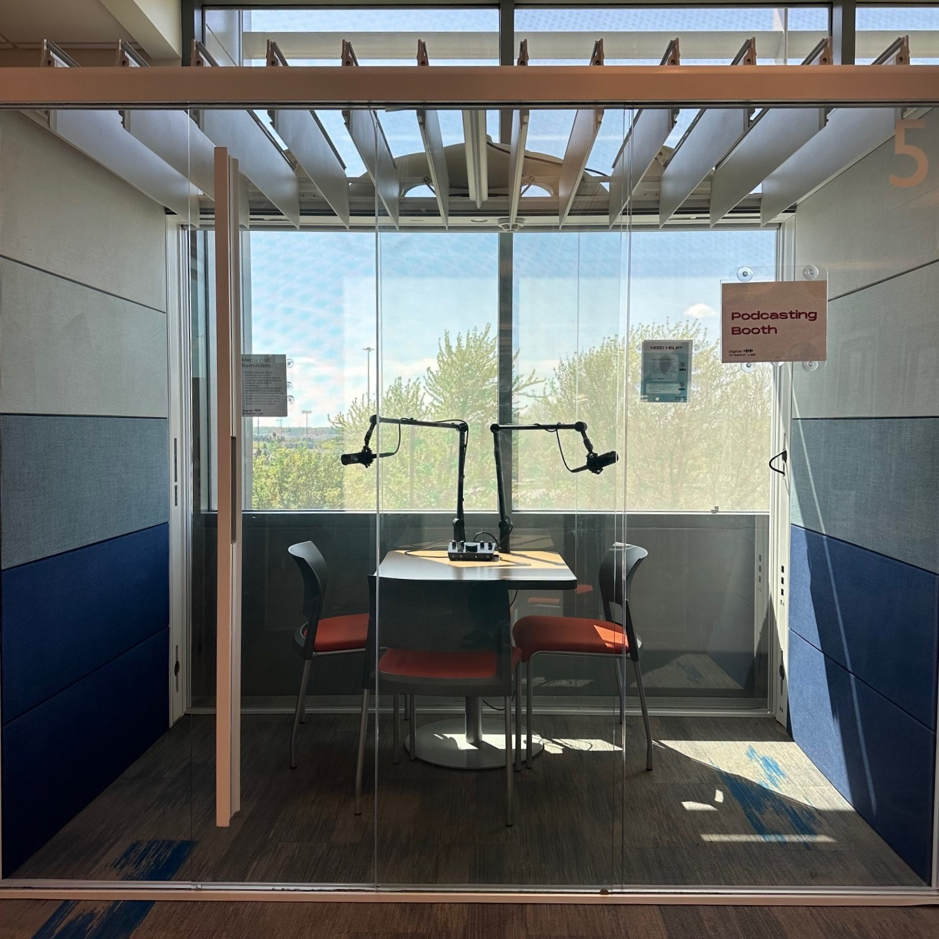

Slide 5
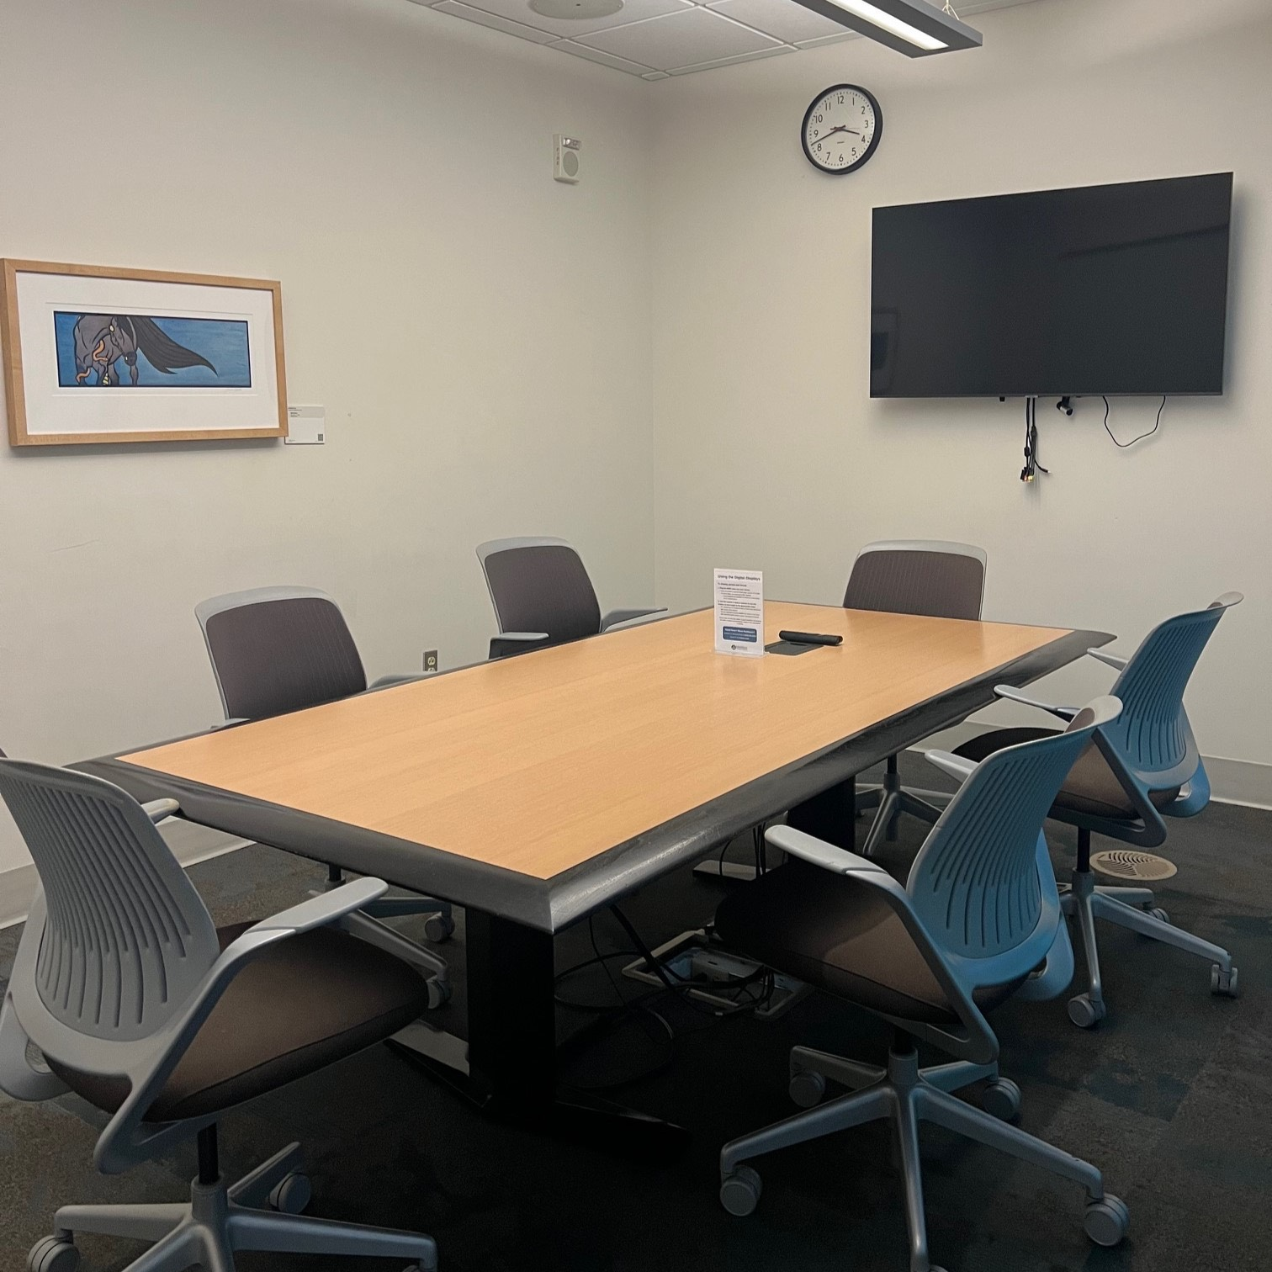

Slide 6
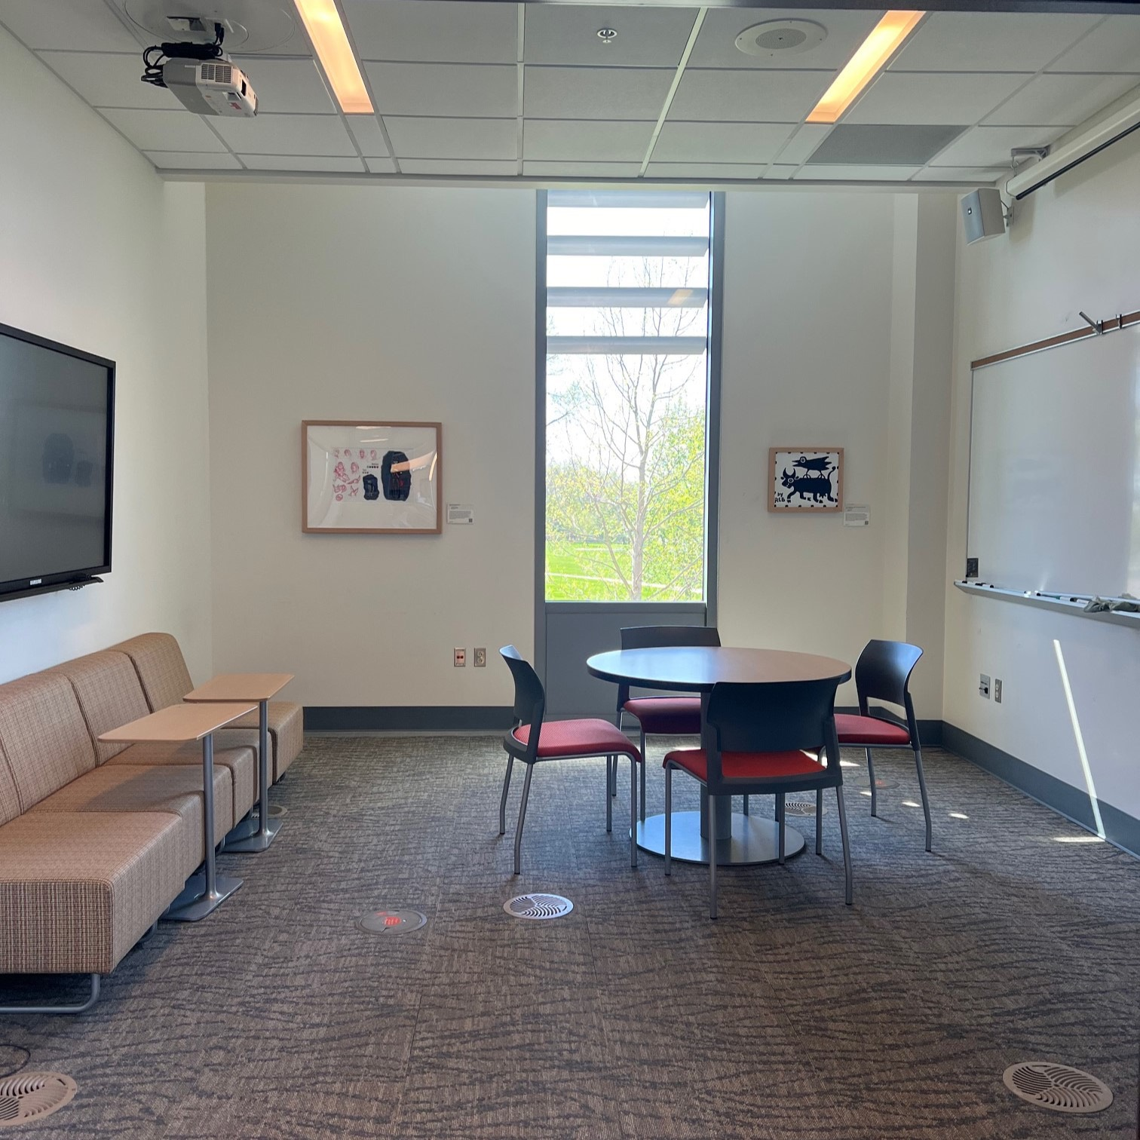

Slide 7
Project Functionalities
Key Features:
Availability
Reservation
Check-in
Cancellation

Slide 8
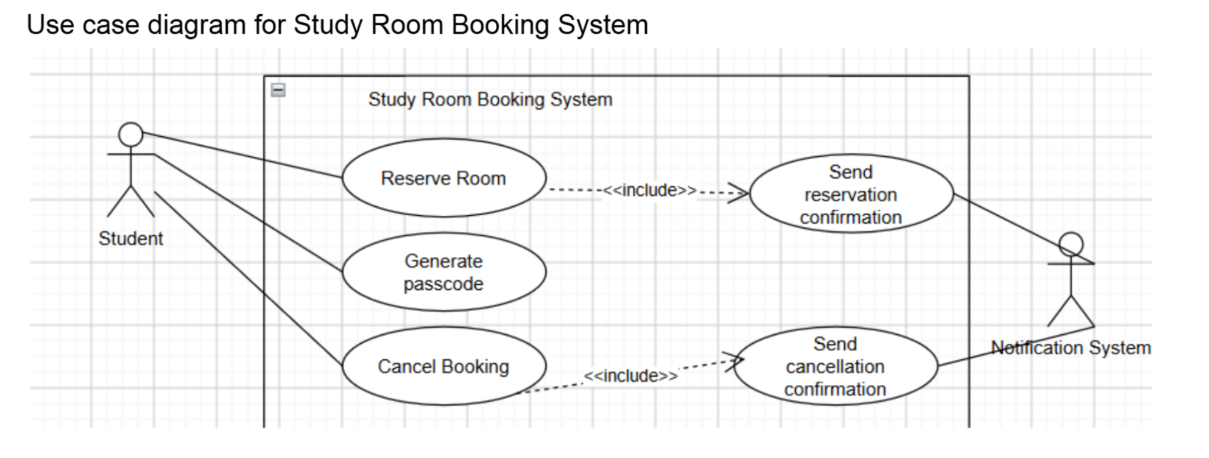
Use Case Diagram

Slide 9
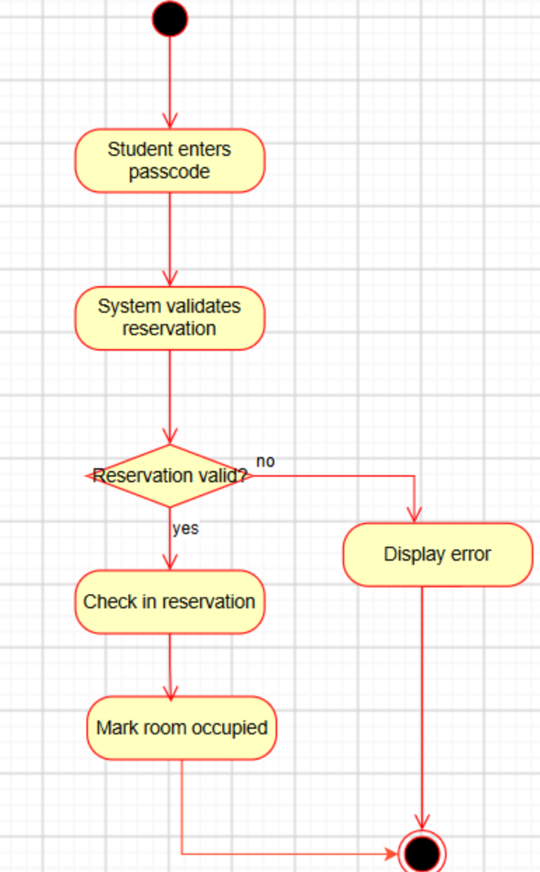
Activity Diagram
Room check in

Slide 10
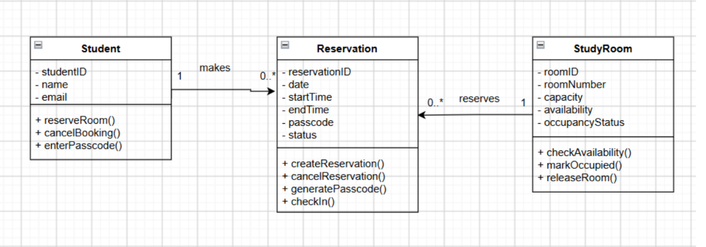
Class Diagram

Slide 11
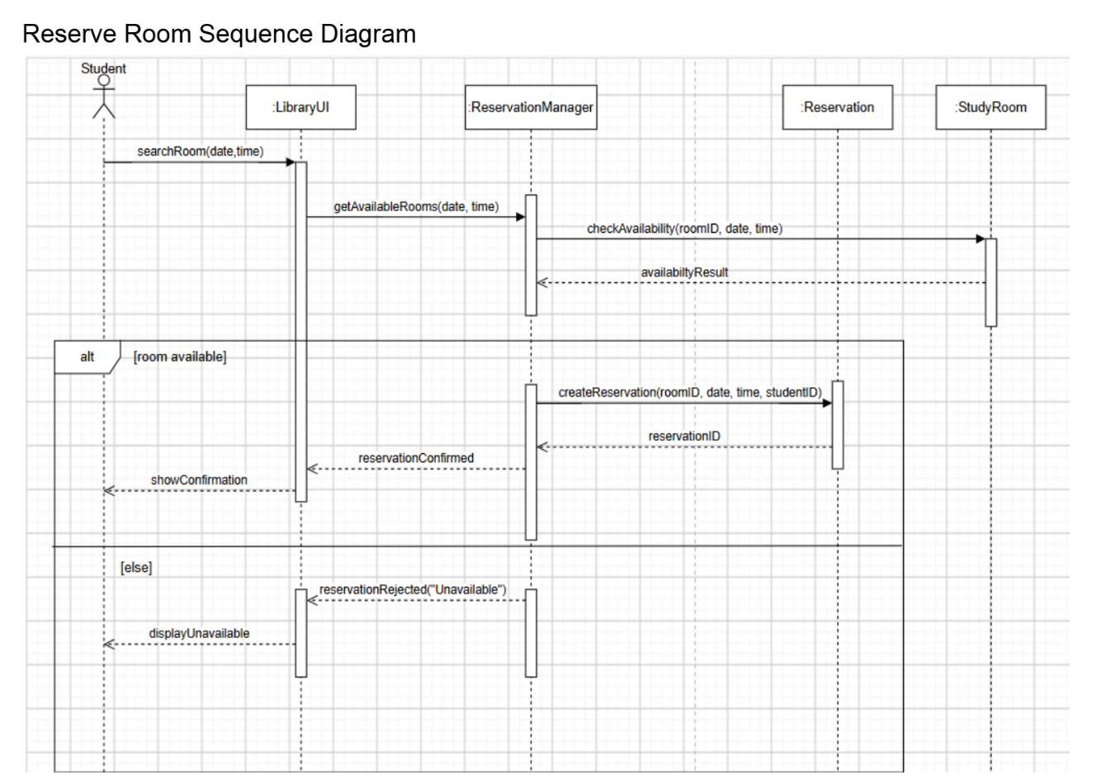
Sequence Diagram

Slide 12
Technology and Team Responsibilities
Python: Reservation and cancellation logic
PostgreSQL: Database management and storage
Streamlit: Front end Development
Team Responsibilities :
Orko: Python backend development and database connectivity
Rachael: PostgreSQL tables and database queries
Lilly: Frontend development , and connecting the interface to backend
Shared: Requirements analysis, UML diagrams, project documentation.

Slide 13
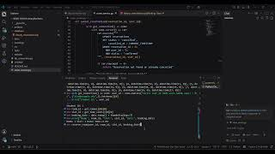
Current Version

Slide 14
Next Steps
Double-Booking Prevention: Test same room reservation
Availability Checking: Display only available rooms
Testing: Functional and integration testing
Check-In Feature: For arriving students
Reservation Validation: Check room capacity etc.
Front-end: Integrate user interface with the Python backend.

Slide 15
Thank You!

